Slide 1

APEC 100 Sustainable Development
Ethics of Sustainable Development

Slide 2
Introduction to Environmental Ethics
Humanistic Ethics
Ethical considerations based on the impacts to humans only.
Naturalistic Ethics
Ethical considerations also based on human impacts and the impacts of other living organisms.

Slide 3
Principle of Double Effect (Aquinas)
The action from which evil results is good or indifferent in itself; it is not morally evil.
The intention of the agent is upright – i.e., the evil effect is sincerely not intended.
The evil effect must be equally immediate causally with the good effect, for otherwise it would be a means to the good effect and would be intended.
There must be a proportionately grave reason for allowing the evil to occur.

Slide 4
Utilitarianism (Bentham)
Maximize aggregate utility
Max ∑U_{i}
Consequentialist in perspective.
Unconcerned about original endowments
The foundation of modern economics and cost-benefit analysis.

Slide 5
Libertarianism (Nozick)
Pareto improvements required.
U_{A}(Y_{A}) ≥ U_{A}(Y_{A}º) and U_{B}(Y_{B}) ≥ U_{B}(Y_{B}º)
Individual freedoms are most important unless others are harmed.

Slide 6
Egalitarianism (Rawls)
Society measured by the status of the worse-off person.
max min {U_{A}, U_{B}}
Who is the worst-off member of society?

Slide 7
Elitism (Nietzche)
Society measured by the status of the best-off person.
max max {U_{A}, U_{B}}
Who is the best-off persons?

Slide 8
Naturalistic Ethics
“Should Trees Have Standing” – Stone 1972
Non-human entities have inherent (though not necessarily equal) rights or standing.
Perhaps greater rights assigned to animals which exhibit higher mental and/or emotional capabilities.
Could be extended to ecosystems or the planet (Gaia Hypothesis)

Slide 9
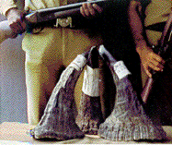
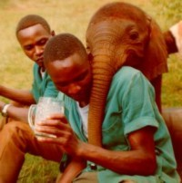
Should Poachers Be Shot On Sight? Efficacy versus Ethics
“Freedom is just another word for having nothing left to lose.”
-- Janis Joplin

Slide 10
Introduction
Brief history of poaching of elephants and rhinos.
Outline a Economic Model of crime
Discuss various anti-poaching policies.
Impact of low non-poaching wages.
Importance of Value of Statistical Life
Examination of the data.
Ethics of the policy from perspective of humanistic and naturalistic philosophies

Slide 11
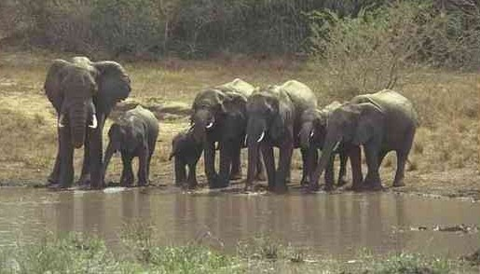
African Elephant Population
From 1981 to 1989, the population has declined roughly 50%.
1,000,000 million to approx. 625,000.
In Kenya, 167,000 in 1973 to 16,000 in 1989.
Twice as many elephants were needed to be killed for each ton of ivory.

Slide 12

Value of Elephant Tusks
8,000 elephants have to be killed to obtain 70 tons of ivory. In 1997, world stockpiles approx 700 tons.
Use of Ivory – Jewelry and home decoration
Rise in price of elephant tusks
1969 - $3/kg.
1978 - $24/kg.
1989 - $50-$150/kg.
(even as high as $300/kg. to $700/kg.)
2002 - $50/kg.

Slide 13
Value of Hunting Elephants
At a price of $150/kg., the income from two elephant tusks can be $3,000.
One tusk can weigh up to 10 kg. (22 lbs.)
One successful hunt can exceed the income for a year of non-poaching. (Kenya’s 1990 GNI = $380) ~ $19/kg.

Slide 14
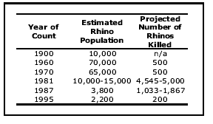
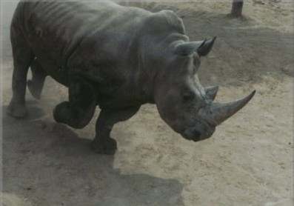
African Rhino Populations
In Africa, the population of rhinos has shrunk even more dramatically.

Slide 15
African Rhino Populations
Only four African countries still have viable rhino populations: South Africa, Zimbabwe, Namibia, and Kenya.
In Kenya, 20,000 in 1970.
Population crashed to 460.
In Zimbabwe, the population of rhinos decreased from at least 5,000 in the 1960s to essentially zero (only in zoos) by 1990.

Slide 16
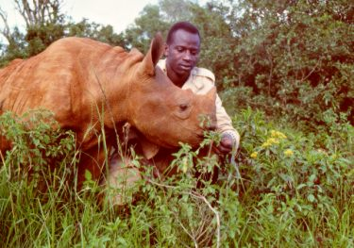
Value of Rhino Horns
Uses
Aphrodisiacs
Asian medicines
Yemen dagger handles
Value of rhino horns (wide range of estimates)
$168/kg.
$1,351/kg.
$3,600/kg.

Slide 17
Value of Rhino Horns
One horn can weigh up to 20 lbs.
Hunting for elephants and rhinos can often be done simultaneously.
Therefore, in 1980s, one hunt could be worth more than 12 years of non-poaching work.

Slide 18
What to do?
Considering the policy options

Slide 19
Anti-poaching Policy Options
Increase the fine, length of imprisonment (F)
Increase anti-poaching enforcement (G)
Increase risk of detection (r_{f})
Lower prices of ivory/rhino horns (P_{E} and P_{R})

Slide 20
CITES (Convention of International Trade In Endangered Species of Wild Fauna And Flora)
Hope to lower prices received by poachers (P_{E} and P_{R}), by reducing international demand.
1977: Ban on trade of rhino horns
No discernable impact on population
1989: Ban on trade of elephant tusks
Since 1994, estimated annual decline of 0.5%-0.6%. (5% normal population growth).
Lifted in 1999 for one-time sale of 60 tons of ivory.

Slide 21
Market-Based Policies
Kremer and Morcom (AER 2000) recommend stockpiling ivory and threaten to flood the market if elephant populations decline.
Brown and Layton (2001) recommend the treatment of rhino horns as a renewable resource and to “harvest” the horns to decrease prices.
Both policies require the lifting of CITES trade bans.

Slide 22
Shoot-on-Sight
Include the possibility of death to the poacher (VSL)
Include the risk of death (r_{d})

Slide 23
Economics of Crime Model
max EU = [1 – r_{d}(G)t_{p}] U(C) (risk of death) (utility from lifetime consumption)
subject to:
wt_{w} + P_{E}E(t_{p}) – r_{f}(G)t_{p}F – C = 0
(wages) (poaching income) (fine/imprisonment)
T = t_{p} + t_{w}
(time spend poaching and working)

Slide 24
Model predictions for Time Spent Poaching (t_{p})
Changes in Market Conditions
Increases in price of ivory or rhino horns?
Increases in the non-poaching wage rate?
Changes in Anti-poaching Effort
Increases in chance of poachers being detected?
Increase in the risk of a fine for poacher?

Slide 25
Model predictions for Time Spent Poaching (t_{p})
Changes in Anti-poaching policies
Increases in the risk of death of poacher?
If no-shoot-on sight policy implemented
Corruption
Impact of corruption of anti-poaching forces?

Slide 26
What does the data and antidotal evidence tell us?

Slide 27
Kenya: Shoot-on-Sight
Richard Leakey introduced Shoot-on-Sight policies as Director of the Kenya Wildlife Service.
100+ poachers killed in first two years.
Elephant population increased at rate of 2.6-4.0%.
Black rhinos in Masai Mara National Reserve increased from 13 to 40 (1985 to 1997).

Slide 28
Zimbabwe: “Operation Stronghold”
First decade: 178+ suspected poachers killed.
40% increase in elephants from 30,000 to 43,000 (1979-1989).
85,000 in 2000.
Essentially 0 to 260 rhinos (1960s-1997).

Slide 29
Nepal
The King of Nepal committed units of the national army to prevent poaching of rhinos:
96 rhinos in 1968.
550 rhinos in 1997.

Slide 30
Elephant Populations by Country

Slide 31
Elephant Populations: Non-Shoot-On-Site Countries

Slide 32
Elephant Populations: Non-Shoot On Site Countries

Slide 33
Shoot-on-Sight: Efficacy and Ethics
“Shoot-on-Sight” policies are the extreme of environmental enforcement policies
Effective at achieving conservation objectives.
Ethically questionable as they appear to violate the Principle of Proportionality.
Consider the ethical traditions discussed earlier in class.

Slide 34
Principle of Double Effect
The action from which evil results is good or indifferent in itself; it is not morally evil.
The intention of the agent is upright – i.e., the evil effect is sincerely not intended.
The evil effect must be equally immediate causally with the good effect, for otherwise it would be a means to the good effect and would be intended.
There must be a proportionately grave reason for allowing the evil to occur.
Are Shoot-on-Site Policies, according to the Principal of Double Effect?
Yes
No
Depends
Don’t Know

Slide 35
Utilitarianism
Maximize aggregate utility
Max ∑U_{i}
Consequentialist in perspective.
Unconcerned about original endowments
Are Shoot-on-Site Policies, according to Utilitarianism?
Yes
No
Depends
Don’t Know

Slide 36
Libertarianism
Pareto improvements required.
U_{A}(Y_{A}) ≥ U_{A}(Y_{A}º)
and
U_{B}(Y_{B}) ≥ U_{B}(Y_{B}º)
Individual freedoms are most important unless others are harmed.
Are Shoot-on-Site Policies, according to Libertarianism?
Yes
No
Depends
Don’t Know

Slide 37
Egalitarianism
Society measured by the status of the worse-off person.
max min {U_{A}, U_{B}}
Are Shoot-on-Site Policies, according to Egalitarianism?
Yes
No
Depends
Don’t Know

Slide 38
Elitism
Society measured by the status of the best-off person.
max max {U_{A}, U_{B}}
Are Shoot-on-Site Policies, according to Elitism?
Yes
No
Depends
Don’t Know

Slide 39
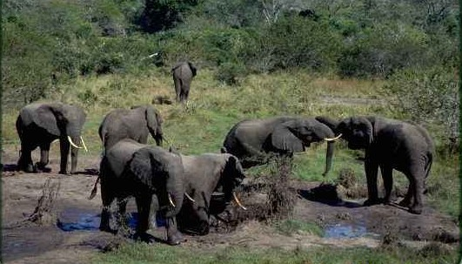
Naturalistic Ethics
“Should Trees Have Standing” – Stone 1972
Non-human entities have inherent, though not necessarily equal, rights or standing.
Are Shoot-on-Site Policies, according to Naturalistic Ethics?
Yes
No
Depends
Don’t Know

Slide 40
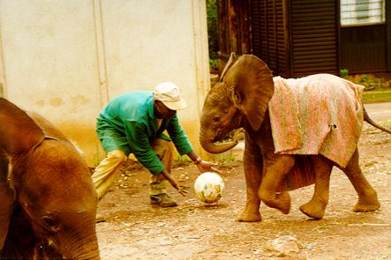
Conclusion
An economic model of crime explains what we observe in the world regarding poaching.
Leaves us to consider the ethics of such policies:
We may expect widely divergent opinions.
International community gave over $153 million to Richard Leakey and was relatively mute about the policies of Zimbabwe and Nepal.
Care for the Wildlife International
Sheldrick foundation, Born Free Foundation
International Fund for Animal Welfare.

